Slide 1
A Seminar on LSTM based OCR
Team Details
G V CHARAN (20EG105112)
B JAHNAVI (20EG105117)
S SAI YASHWANTH (20EG105147)
R JOSHUA RAHUL (20EG105713)
Project Supervisor
Dr K Shailaja
Assistant Professor

Slide 2
Introduction
OCR stands for Optical Character Recognition, which is a technology that enables the automatic conversion of scanned or printed text into digital data that can be manipulated by computer systems.
OCR can perform a range of tasks, such as:
Scanned document recognition: OCR can convert scanned documents into searchable and editable texts, making it possible to digitize old printed documents and integrate them into modern workflows. This is useful for tasks such as legal document processing, invoice processing, and bank statement extraction.
Scene text recognition: OCR can recognize text in images captured under various conditions, such as low light, blurry images, or images with non-uniform backgrounds. This is useful for tasks such as street sign recognition, storefront recognition, or license plate recognition.
Intelligent Character Recognition (ICR): OCR can recognize and transcribe handwritten or cursive text from scanned documents, making it possible to digitize handwritten notes, letters, and forms. Script recognition is a specific application of OCR that focuses on transcribing cursive and script handwriting.

Slide 3
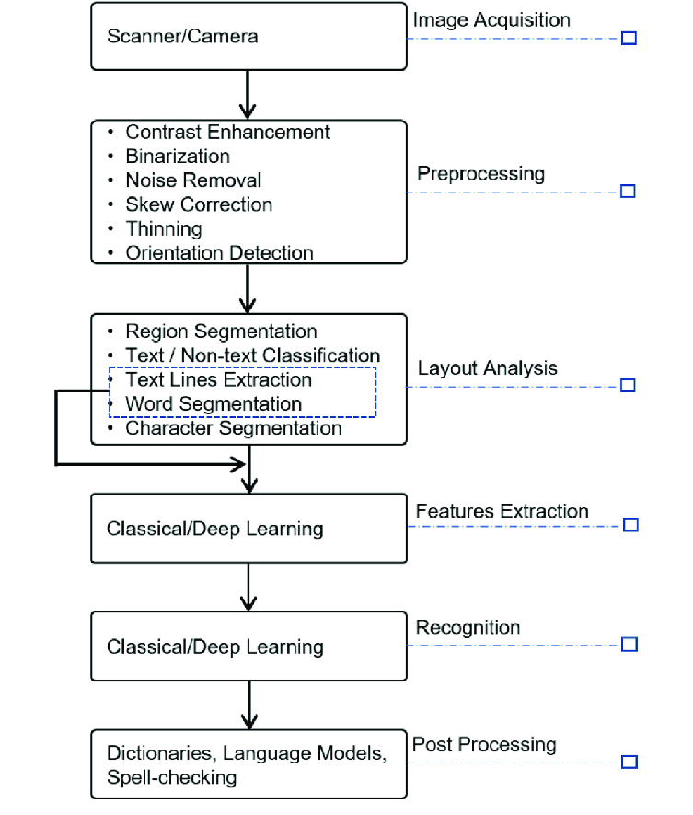
Concept Tree

Slide 4
Literature
Author(s) | Method/Strategy | Advantages | Disadvantages
Yiyi Liu ; Yuxin Wang; Hongjian Shi 2023 | “A Convolutional Recurrent Neural-Network-Based Machine Learning for Scene Text Recognition Application” 1.DBNet is a novel network architecture for real-time scene text detection 2.Paddle text direction classiﬁer is a module that is added between the text detection and recognition modules to deal with text in different directions. 3.Prediction: Classify new websites based on extracted features using the trained algorithms. | Model can effectively segment and recognize text in various backgrounds and orientations by applying the afﬁne transformation, text direction classiﬁcation, and clarity evaluation. | 1. Low accuracy for short texts with signiﬁcant deformations, such as art terms or texts describing scenes in the natural world. 2. Limitations of CRNN in complex and multi-oriented text scenes.
Rakesh Chandra; Surajit Mohanty; Marimuthu Karuppiah; | “Implicit Language Model in LSTM for OCR” 1. Skew correction, Word segmentation, Character segmentation, Recognition, Inspired by the success of deep neural networks for feature learning, we have explored CNNs to classify the characters and proposed a new architecture for the same. | 94.32% Model Accuracy | 1. Segmentation algorithm can be improved so that every character is segmented together with its vattu and gunintham.

Slide 5
Problem Statement
To develop a OCR tool to recognize Telugu scripts using techniques of OpenCV and deep learning(LSTM)
The aim of this project is to develop an OCR system for Telugu script using Long Short-Term Memory (LSTM) networks, a type of recurrent neural network that can learn long-term dependencies in sequential data. LSTM networks have shown promising results in OCR for other languages, such as English and Arabic.
The objectives of this project are:
To collect and annotate a large and diverse dataset of Telugu text images, covering different writing styles, fonts, and layouts.
To design and implement LSTM networks for character recognition, and compare their performance with other deep learning models, such as convolutional neural networks and encoder-decoder networks.
To evaluate the accuracy and efficiency of the proposed system on various metrics, such as character error rate, word error rate, and recognition time.
To explore the potential applications and limitations of the proposed system, and suggest possible improvements and extensions.

Slide 6
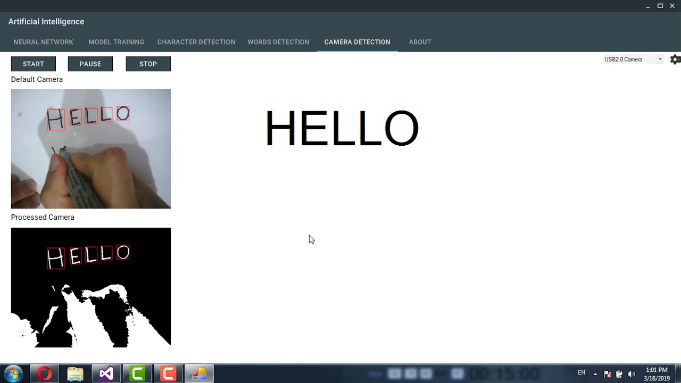
Illustration

Slide 7
Proposed Method
Preprocess the input image by applying binarization, noise removal, skew correction, and resizing techniques to enhance the quality and uniformity of the image.
Segment the image into lines, words, and characters using a combination of projection profiles, connected components, and contour analysis. Alternatively, use a segmentation-free approach that directly extracts features from the whole image or patches of the image.
Extract features from the segmented or whole image using convolutional neural networks (CNNs), which can learn robust and invariant representations of the characters. Use max-pooling and dropout layers to reduce the dimensionality and overfitting of the features.
Feed the sequence of features extracted by the CNNs to a recurrent neural network (RNN) with long short-term memory (LSTM) cells, which can learn the temporal dependencies and context information of the characters. Use a bidirectional RNN to capture both forward and backward information from the sequence.
Use a connectionist temporal classification (CTC) loss function to train the RNN-LSTM network, which can handle variable-length inputs and outputs without requiring explicit alignment. CTC can also output a blank symbol to indicate no character or a repeated character in the sequence.
Use a beam search decoder to find the most probable output sequence from the network, which can also incorporate a language model to improve the accuracy and fluency of the output. Alternatively, use an attention mechanism to selectively focus on different parts of the input image and generate the output sequence one character at a time.

Slide 8
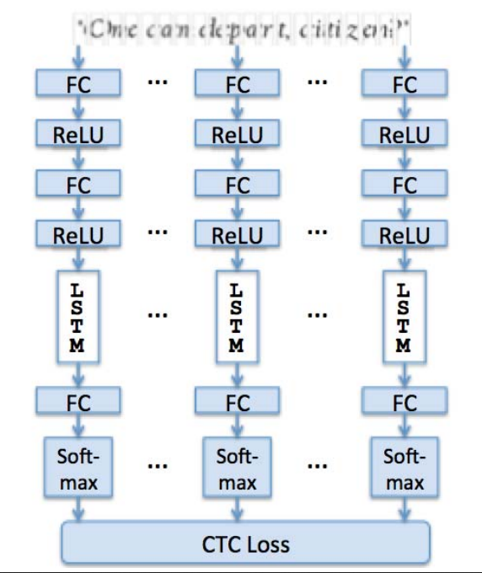
Proposed Method Illustration

Slide 9
Experiment Environment
Software requirements
Visual Studio
Python
OpenCv
Tensorflow

Slide 10
Project status
S.No | Functionality | Status (Completed /in-progress/Not started)
1. | Dataset Preprocessing | Completed
2. | Feature Extraction | Completed
3. | Recognition | In-progress
4. | GUI Integration | Not Started

Slide 11
References
[1]. Yiyi Liu, Yuxin Wang, Hongjian Shi (2023) A Convolutional Recurrent Neural-Network-Based Machine Learning for Scene Text Recognition Application.
[2]. Rakesh Chandra Balabantaray, Surajit Mohanty, Marimuthu Karuppiah, Debabrata Samanta (2022). Approach for Preprocessing in Offline Optical Character Recognition (OCR).
[3]. Ekraam Sabir, Stephen Rawls, Prem Natarajan (2020). Implicit Language Model in LSTM for OCR.

Slide 12
Thank you

Slide 13
Project seminar–I Evaluation
S.No | Rubrics | Marks
1 | Concept Introduction | 4
2 | Literature and Parameter | 5
3 | Problem and Problem Illustration | 8
4 | Proposed Method and Illustration | 8
Total |  | 25

